Slide 1
Zillow Sum Game
Team Data JAM
By:
Joe Casino
Alex Koynoff
Maralee Capella

Slide 2
Overview of Topic
Core question: Does more equal higher appreciation of home prices?
Core strategy: Compare historical prices for 14,000+ zip codes throughout the United States against various variables to find if any correlations exist.

Slide 3
Questions and Data
Questions asked:
Have home prices increased over time and does higher income mean higher home prices?
Do Americans generally buy more expensive homes the more they make?
Do Americans under or over spend on homes?
Does the number of various data points mean higher home prices?
For example, does having more Starbucks coffee shops in your zip code lead to higher home price appreciation?
Do demographics impact home price appreciation?
How do median age, poverty, unemployment, and the count of Bachelor’s degrees in a zip code impact home price appreciation?
Data needed:
Historical home prices throughout the USA obtained from Zillow.
Points of interest to gather count of various variables from Foursquare API.
Demographics obtained from Census API.

Slide 4
Data Cleanup and Exploration
Finding/Retrieving right data not as easy as we thought
Zillow Home Prices (Easy)
Census Data (Medium)
Establishment Data (Hard)
Due to size of home price dataset, much faster to clean/manipulate in Python vs. Excel
API Usage
Hit into retrieval limit
Speed considerations depending on the volume of data being requested
Ended up using random sample of zip codes instead of entire data set

Slide 5
Data Analysis
Graphical representation utilizing Matplotlib was beneficial.
Many ways to visualize same data provided opportunities to view the data from different points of view (scatter vs bar, heat maps, etc).

Slide 6
Home Price Trends
Review of home price trends by state

Slide 7
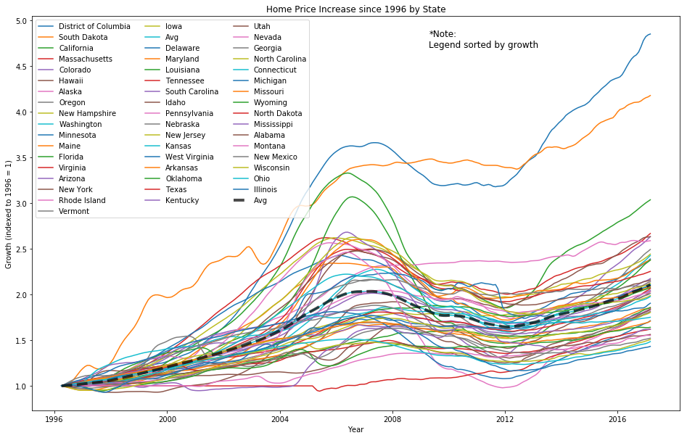
Overview | Home Prices over Time
Takeaway: invest in real-estate (but not in Illinois)!

Slide 8
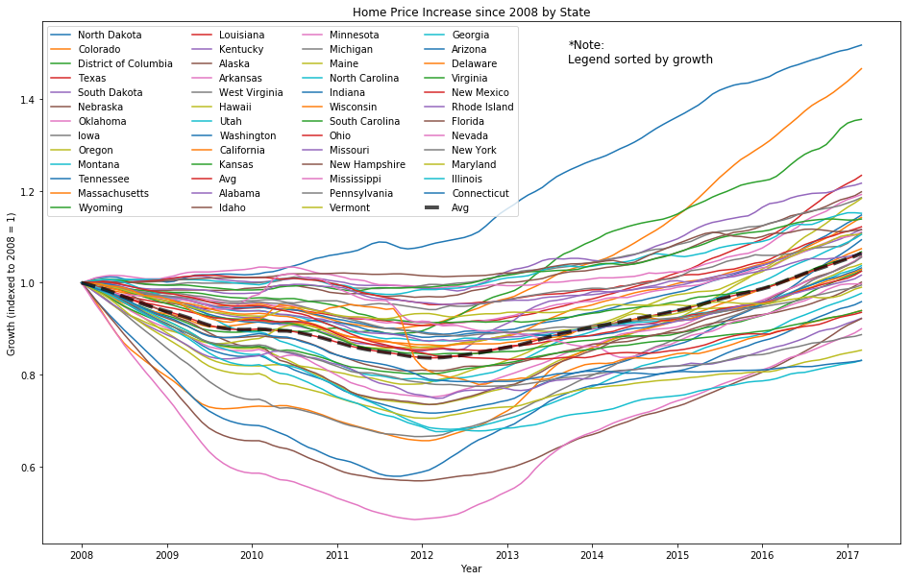
Home Prices over Time | Since Financial Crisis
Takeaway: North Dakota...South Dakota...Texas. Follow the oil!

Slide 9
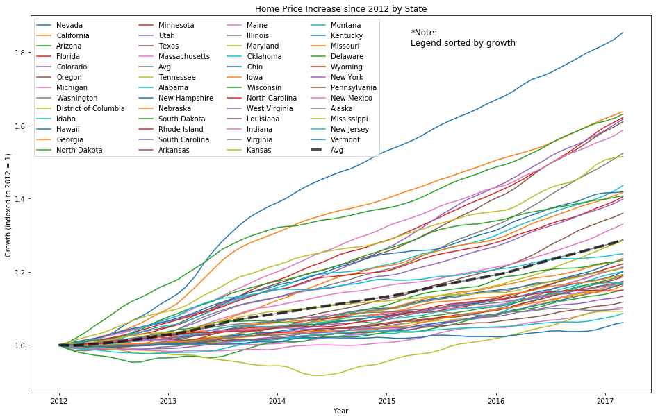
Home Prices over Time | Past 5 years
Takeaway: American’s getting sick of winter? Baby Boomer relocation affecting housing prices?

Slide 10
State Level: Home Prices vs Income Levels
Does higher income mean higher home prices?
Do Americans generally buy more expensive homes the more money they make?
Do Americans under or over spend on homes based on their income level?

Slide 11
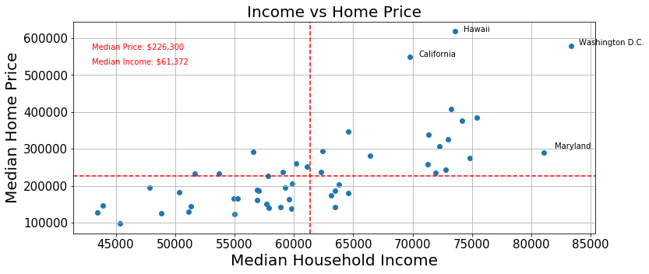
Median Home Prices to Median Household Income
Higher household income correlates to higher home prices.

Slide 12
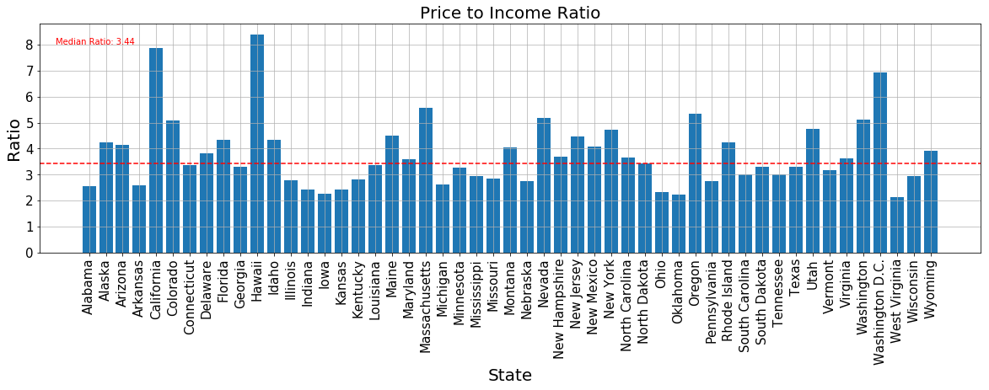
Price to Income Ratio
Some states tend to underspend while others overspend.

Slide 13
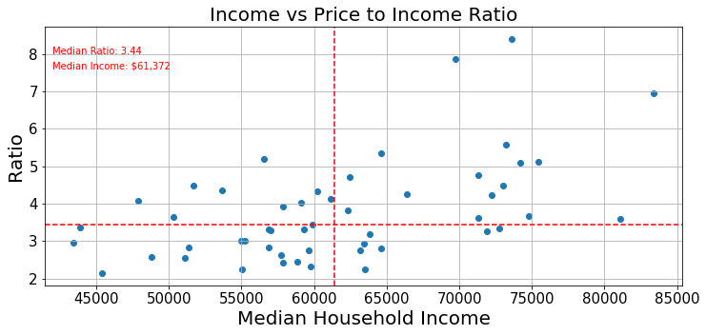
Income to Ratio
Households with incomes above the median household income level tend to slightly spend more on homes compared to households below the median household income.

Slide 14
Home Prices vs Points of Interests
How does the count and distance of various points of interest impact home prices?
Does having more Starbucks coffee shops in your zip code lead to higher home price appreciation?

Slide 15
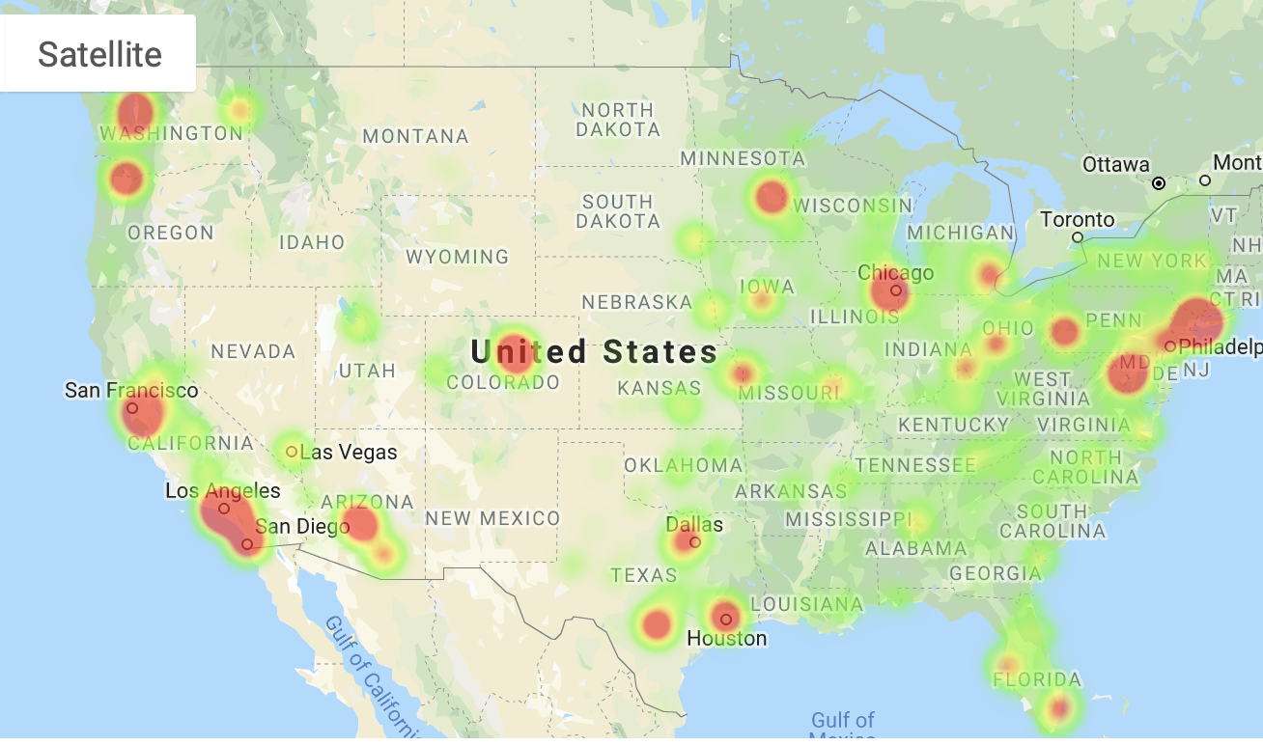
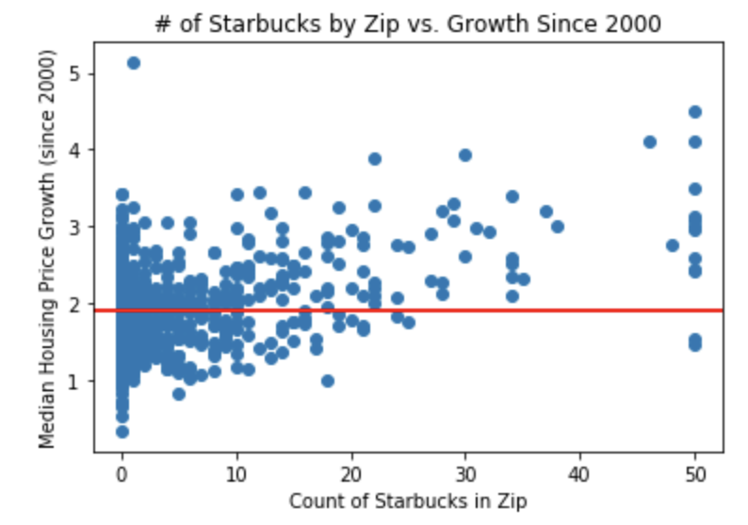
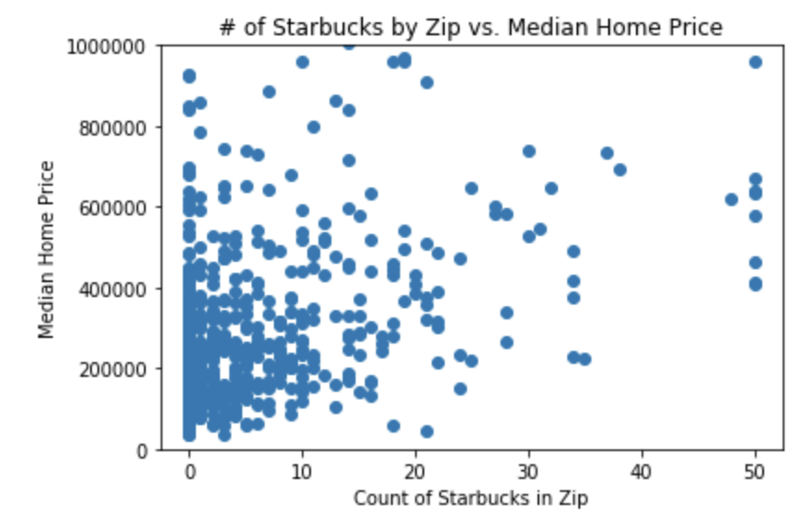
Starbucks vs Home Prices
Using FourSquare API, able to ‘count’ establishments within a given radius of zip
Starbucks ‘density’ seems to correlate well with home price, however cognizant of ‘city bias’
More interestingly, growth rate (since 2000) of home prices in areas with 20+ Starbucks within a 4mi radius outperformed the nat’l avg
Causality vs. Causation?

Slide 16
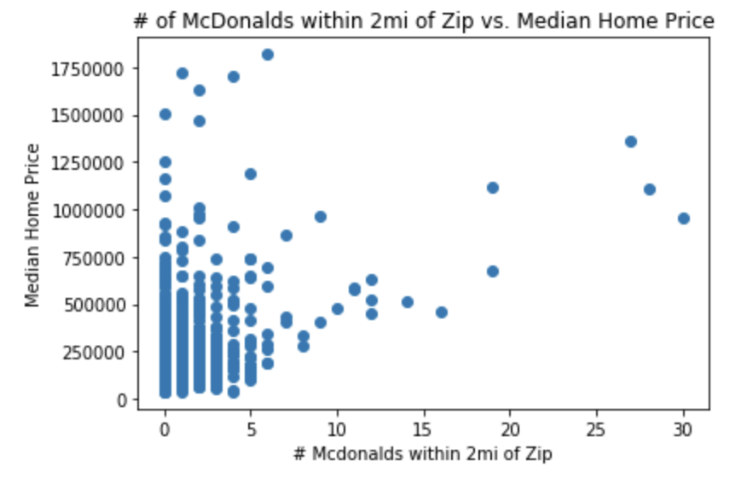
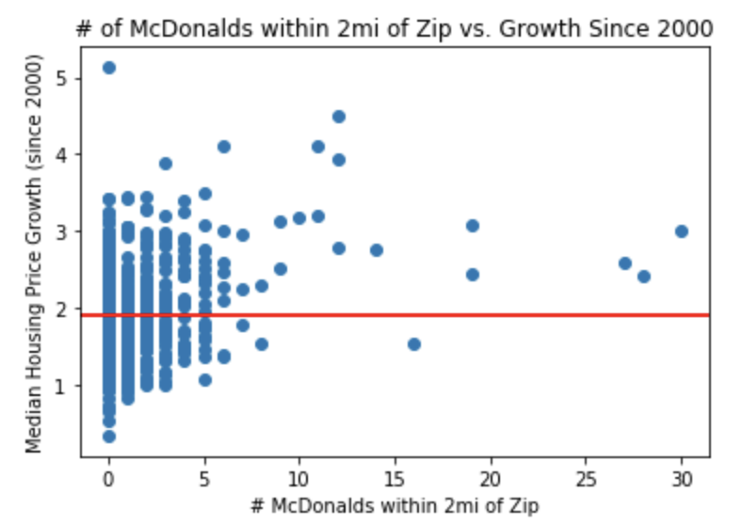
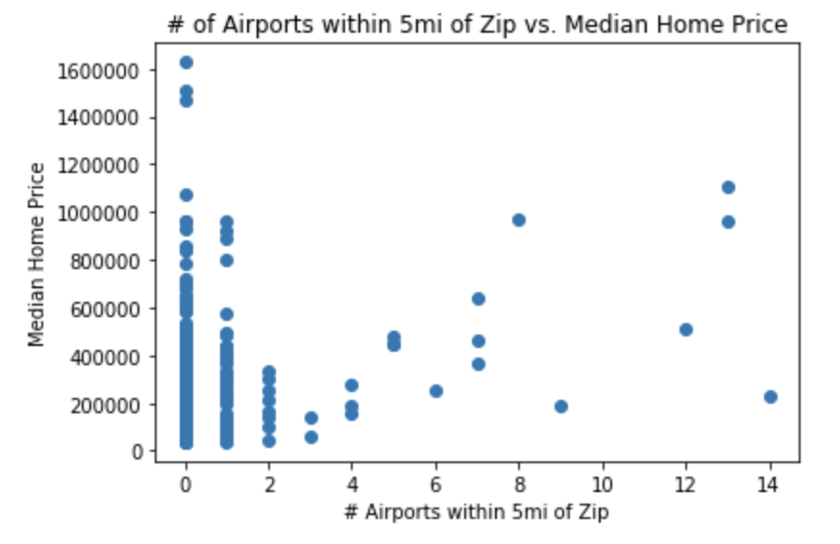
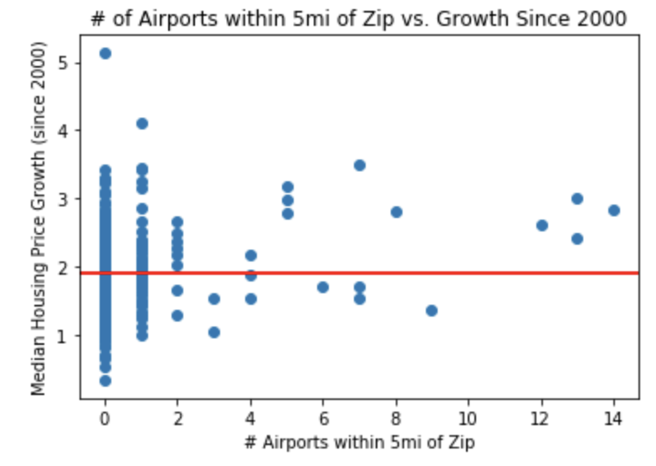
Other Variables vs Home Prices

Slide 17
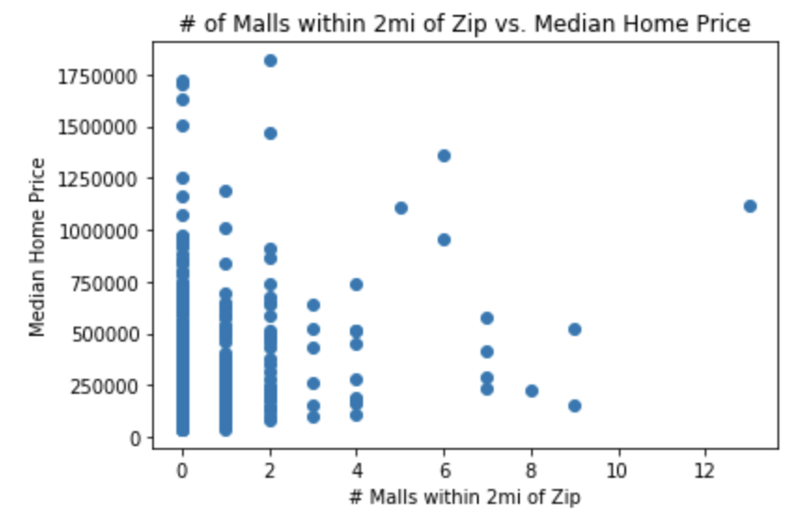
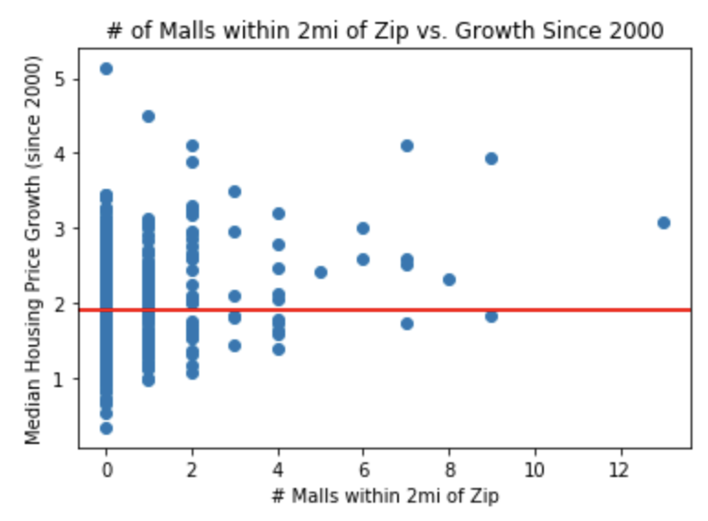
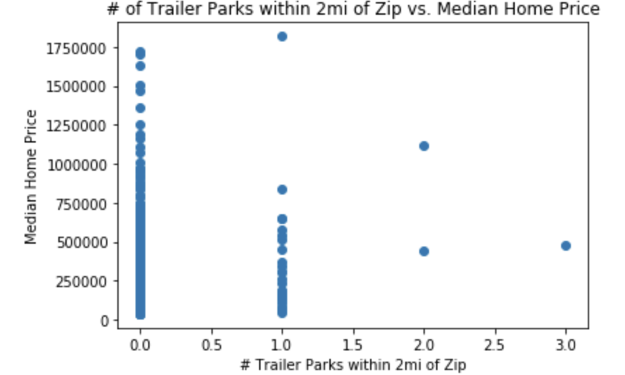
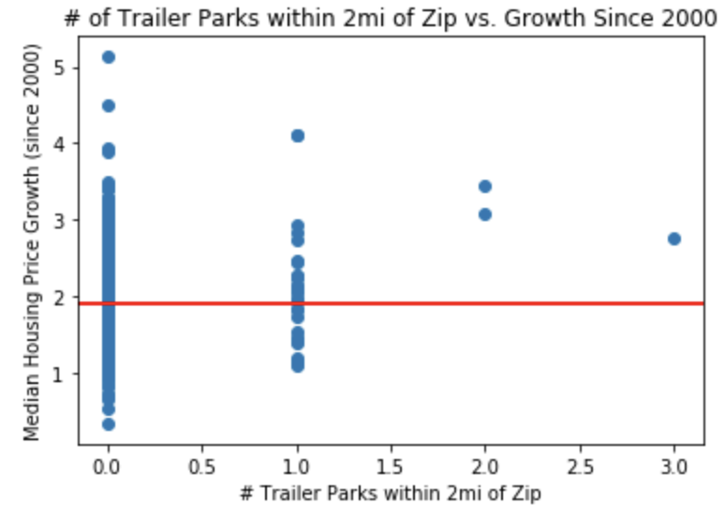
Other Variables vs Home Prices

Slide 18
Zip Code Level: Home Prices vs Proximity to Airports
Does proximity to a major airport increase or decrease median home price?
Does the relationship change over time (house prices from 2000 vs 2018)?
What trends can be observed?

Slide 19
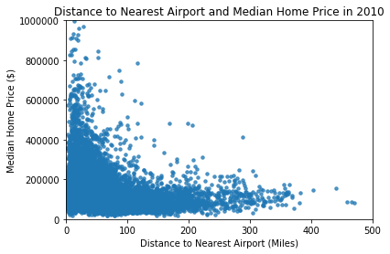
Distance to Nearest Airport and Median Home Price (2010)
These data suggest that there was a greater density of homes closer to major airports (presumably urban and more-developed areas). Although there appears to be not much of a relationship when the nearest airport is within 100 miles, when the distance becomes greater, the median home price decreases.

Slide 20
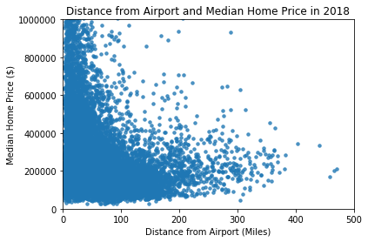
Distance to Nearest Airport and Median Home Price (2018)
The trends for 2018 seem similar to 2010. These data suggest that home prices increased in many areas. Also, it seems that median home prices didn’t decrease as sharply when distance from nearest airport increased (as compared to 2010).

Slide 21
Zip Code Level: Home Prices vs Demographics
Do demographics impact home price appreciation*?
How do median age, poverty, unemployment, and the count of Bachelor degrees in a zip code impact home price appreciation?
*Home price appreciation is from 2000 to 2018 using Zillow median prices per zip code.

Slide 22
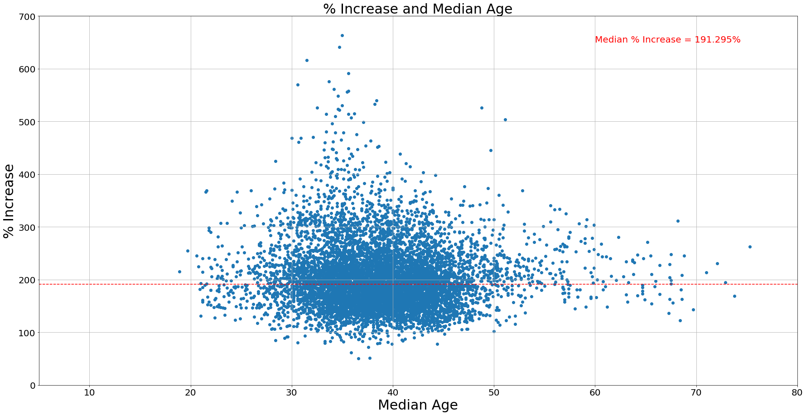
Percent Increase in Home Values vs Median Age
Median age in the mid to high 30s look to have experienced a higher percentage increase.

Slide 23
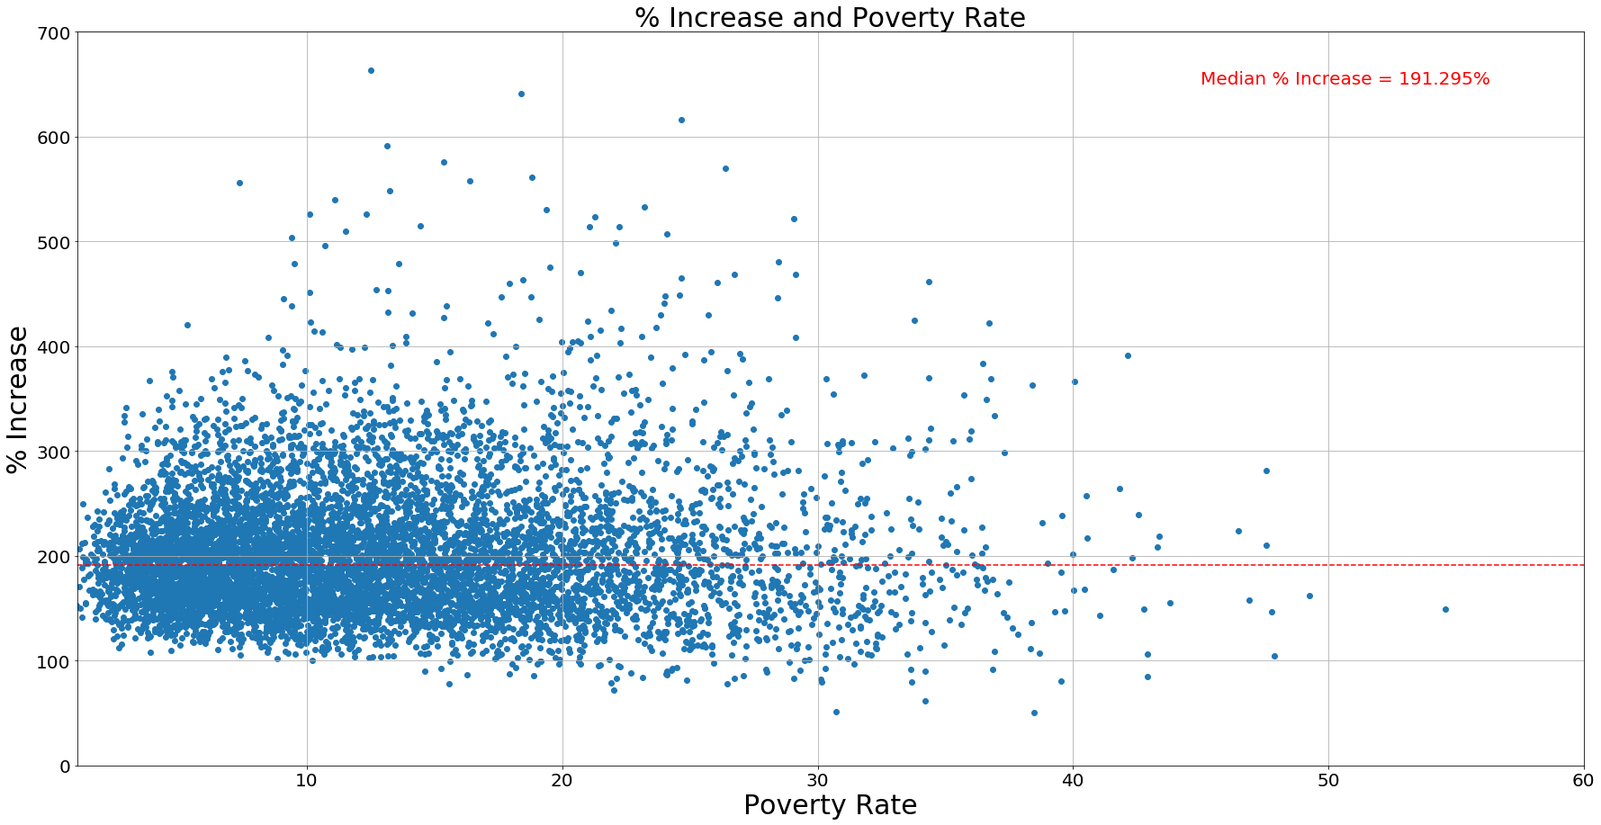
Percent Increase in Home Values vs Poverty Rate
Lower poverty rate tends to lead to higher percent increase in home values.

Slide 24
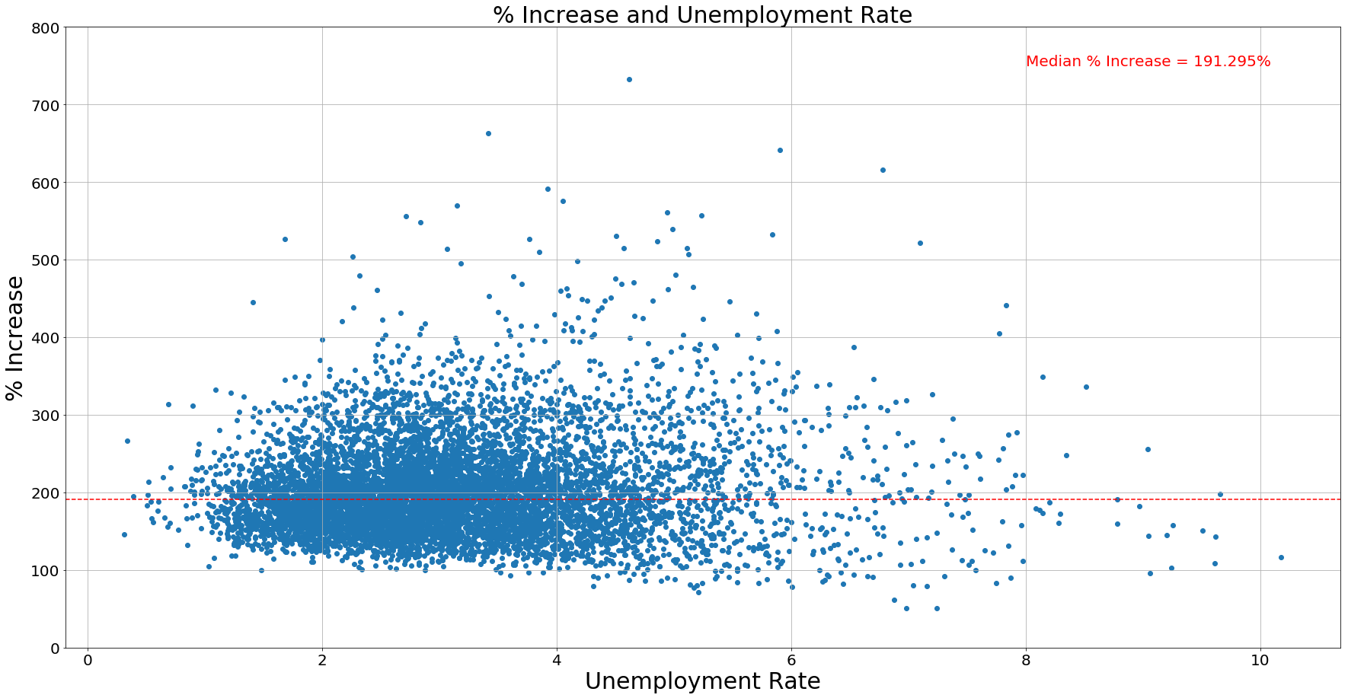
Percent Increase in Home Values vs Unemployment Rate
While not 100% clear, lower unemployment rate tends to correlate with higher increase of home prices.

Slide 25
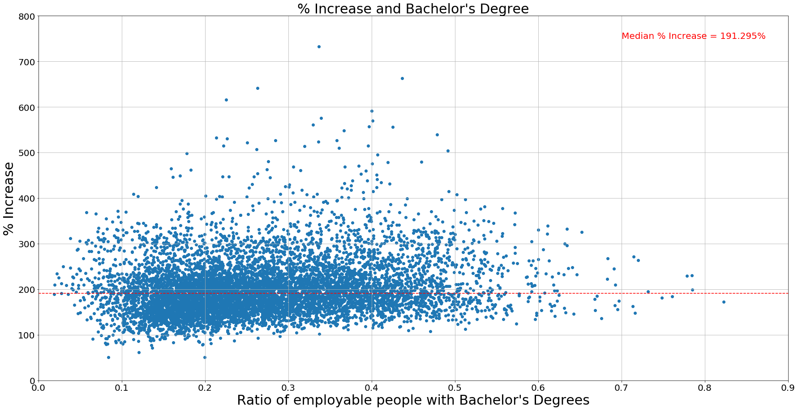
Percent Increase in Home Values vs People with Bachelor's Degree
Zip codes with higher ratio of employable people with Bachelor’s degrees look to have a slight upward trend

Slide 26
Conclusion
As expected, median home prices in the United States have increased over time.
There is a slightly positive correlation between annual household income and median home price.
Other factors such as number of Starbucks, McDonalds, and airports might show a weak relationship to home prices. Additional, more targeted analysis might provide a different picture.
While our data and graphs may suggest certain trends, median home prices cannot be attributed to a single factor, and it’s important to recognize that correlation does not imply causation.
If we had more time, we would do a more targeted analysis such as zip codes within a metro area, which might provide more concrete analysis if any relationships exist.
Using all 14,000+ zip codes might be too broad which captures many diverse factors.

Slide 27


